Slide 1
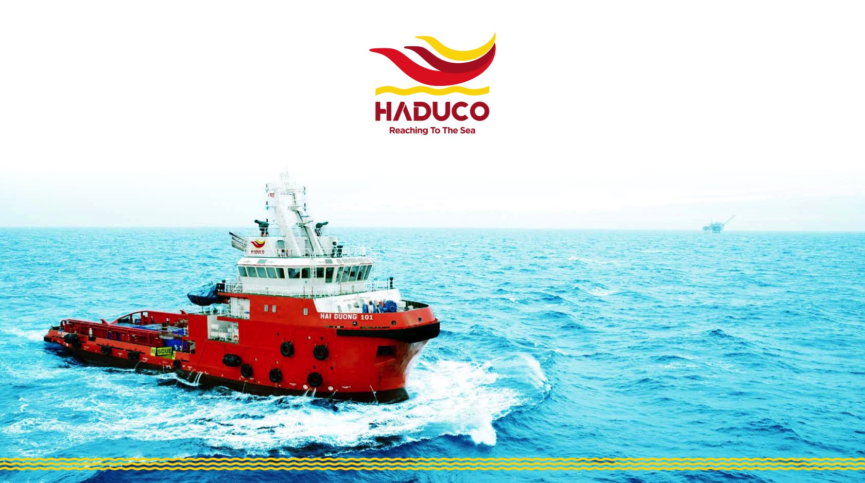
DEVELOPMENT PLAN

Slide 2
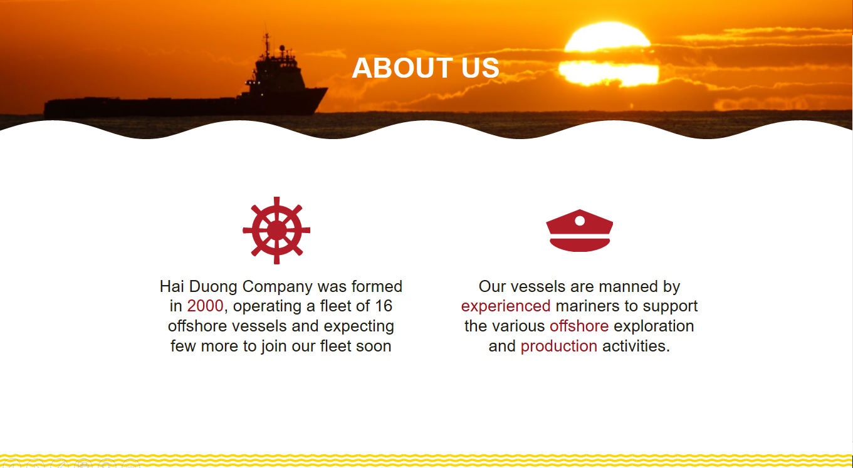
HADUCO PRESENTATION
26
Notes:
Revise the number of vessel in fleet: 26 vessels

Slide 3
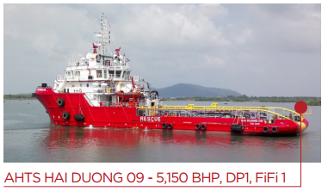
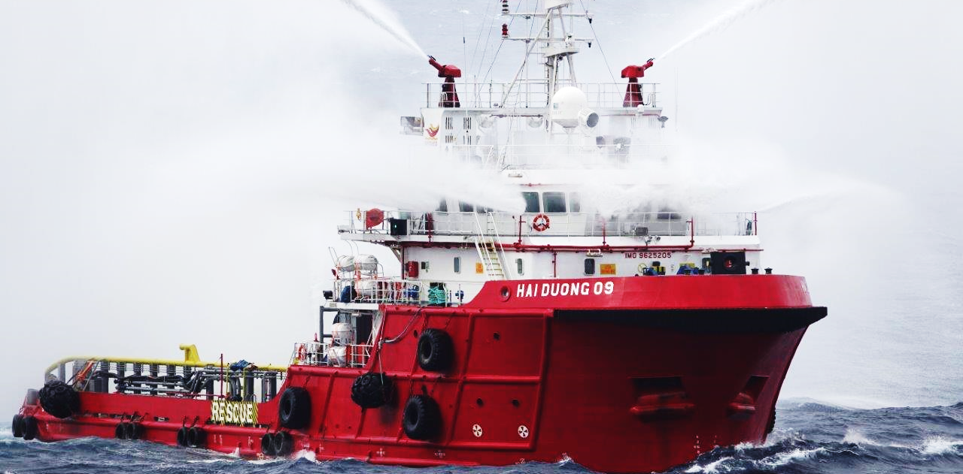
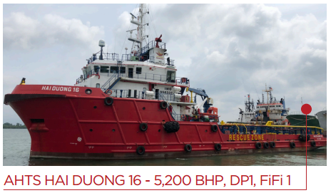
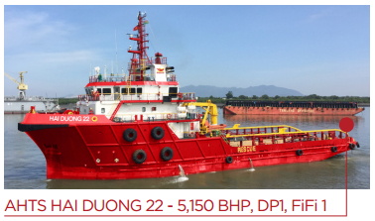
HADUCO PRESENTATION
VESSELS SERVED LAN TAY FIELD
AHTS -HAI DUONG 89
Notes:
It’s our honor to serve Rosneft Vietnam. Since Feb/2018, we had HD09 working for long-term standby contract at Lan Tay field. And up to now, there are more and more vessels working for Rosneft such as: Sea Meadow 05, Sea Meadow 19, Sea Meadow 29, Sea Meadow 18, Sea Meadow 22 which served for your two drilling campaigns
Haduco hopes for a long-lasting relationship with Rosneft in the up-coming time.
In order to keep our vessels serving your esteemed company smoothly in safest manner and high effectiveness, we do have improvements which are the key contents of our meeting today. Now I am going to show you how we make it.

Slide 4
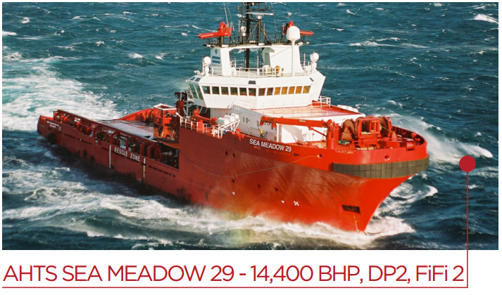
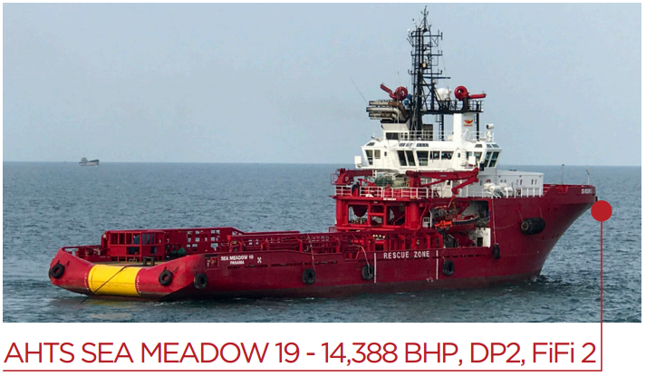
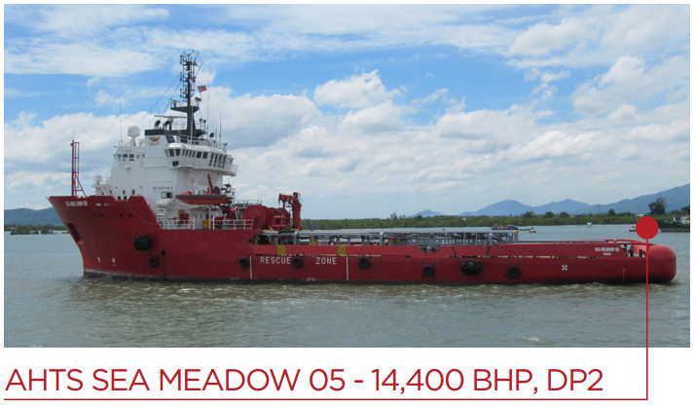
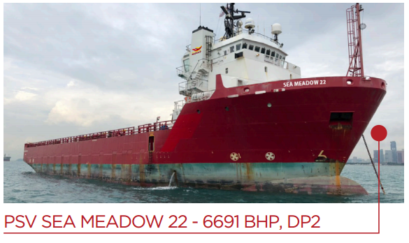
HADUCO PRESENTATION
VESSELS SERVED YOUR TWO DRILLING CAMPAIGNS
Notes:
2018 Rosneft Drilling:
SMD19: full time support for PVD6
SMD29: towing support for H5
SMD05: rig positioning for PVD6, assist tow PVD6, main tow H5,
SMD12: supply for H5
SMD18: equipment and personnel transfer for PVD6
2019 Rosneft Drilling:
SMD29: full time support for H5
SMD19: deploy anchor for H5
SMD22: supply run for H5

Slide 5
HADUCO PRESENTATION
VESSELS SERVED FOR YOUR 2018 DRILLING CAMPAIGNS
SUPPORT FOR PVD6:
Sea Meadow 19
Sea Meadow 05
Sea Meadow 18
SUPPORT FOR HAKURYU5:
Sea Meadow 29
Sea Meadow 05
Sea Meadow 12
Notes:
2018 Rosneft Drilling:
SMD19: full time support for PVD6
SMD29: towing support for H5
SMD05: rig positioning for PVD6, assist tow PVD6, main tow H5,
SMD12: supply for H5
SMD18: equipment and personnel transfer for PVD6

Slide 6
HADUCO PRESENTATION
VESSELS SERVED FOR YOUR 2019 DRILLING CAMPAIGNS
SUPPORT FOR HAKURYU5:
Sea Meadow 29
Sea Meadow 19
Sea Meadow 22
Notes:
2019 Rosneft Drilling:
SMD29: full time support for H5
SMD19: running anchor for Hakuryu 5
SMD22: supply run for H5

Slide 7
TABLE OF CONTENTS
Review maintenance plan and management system & what do you do differently to improve the effectiveness of maintenance management?
Review vessel mobilization procedure
Have an integrated resource development plan covering hardware, software and people together with Haduco’s business development plan

Slide 8
Review maintenance plan and management system
What do we do differently to improve the effectiveness of maintenance management?

Slide 9
OUR MAINTENANCE STRATEGY IS TO BE PRO-ACTIVE AND FOCUS ON PREVENTIVE MAINTENANCE
OUR VESSEL FLEET IS CLASSED BY FAMOUS CLASSES SUCH AS DNV-GL OR ABS
We always comply with the Class Requirements for Special Survey/Intermediate Survey, Annual Survey. Noticeably, at the Special Surveys (Every 5 years), all machineries and equipment onboard are maintained/overhauled under witness by Class.
We base our Maintenance Plan on Maintenance Instructions/Recommendation from well-qualified makers. Haduco is currently using two PSM systems in parallel.
Hard copy of PMS
HDC-11-01 “Planned Maintenance System” is being used onboard, all maintenance works which are done monthly will be sent to office for review and saved on company server of Technical Department.
GPMS
This PMS system which can be online working in connection with our office, all maintenance works will be carried out/updated on GPMS. All nearly overdue items will be alarmed to office by colored code at frequency of 180 days (light yellow at 30 days in advance, dark yellow at 10 days in advance, red for overdue items).

Slide 10
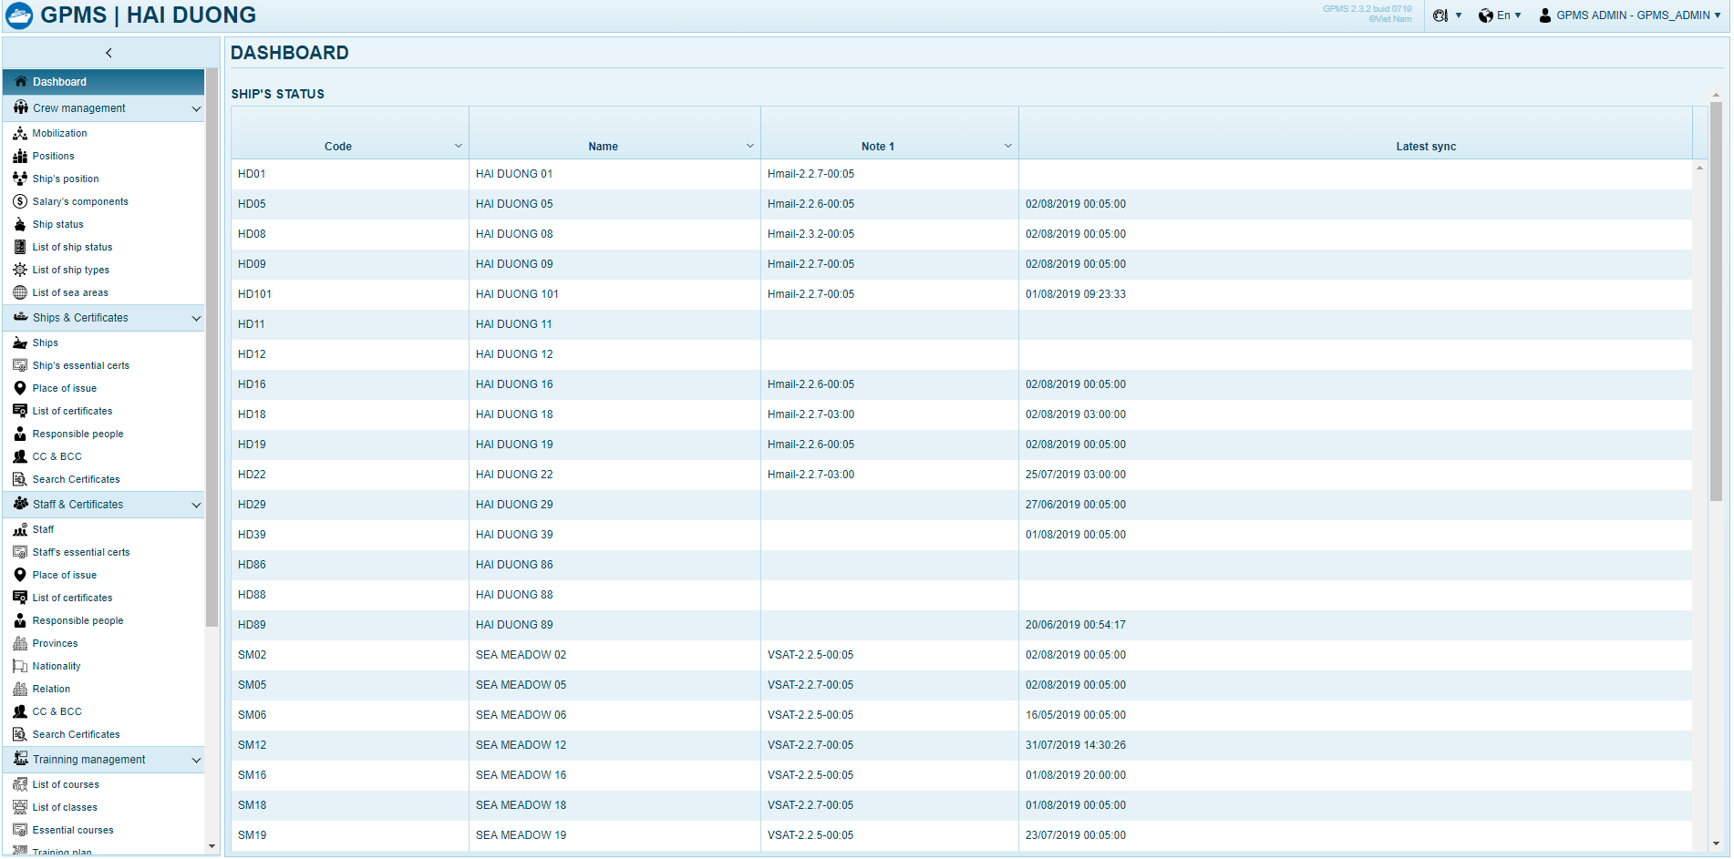
Hinh GPMS

Slide 11
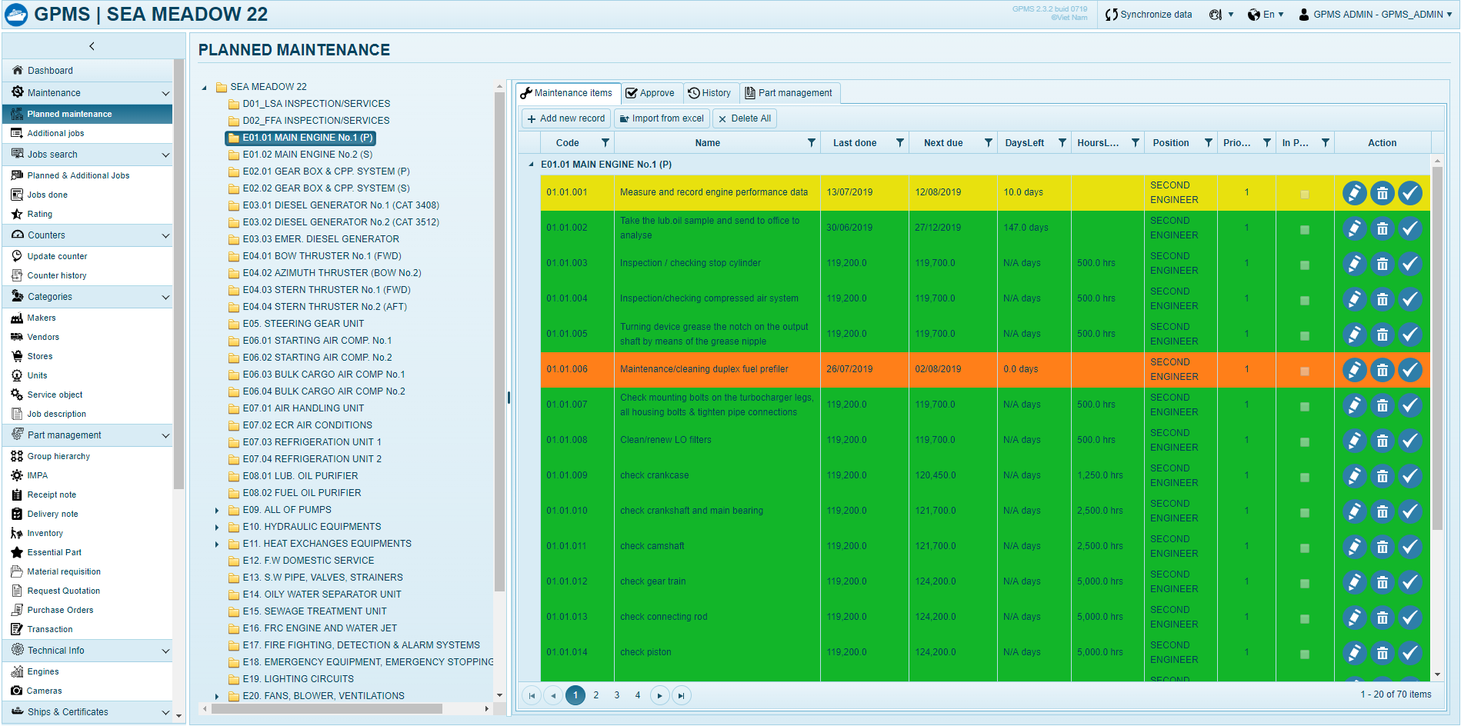
Hinh GPMS

Slide 12
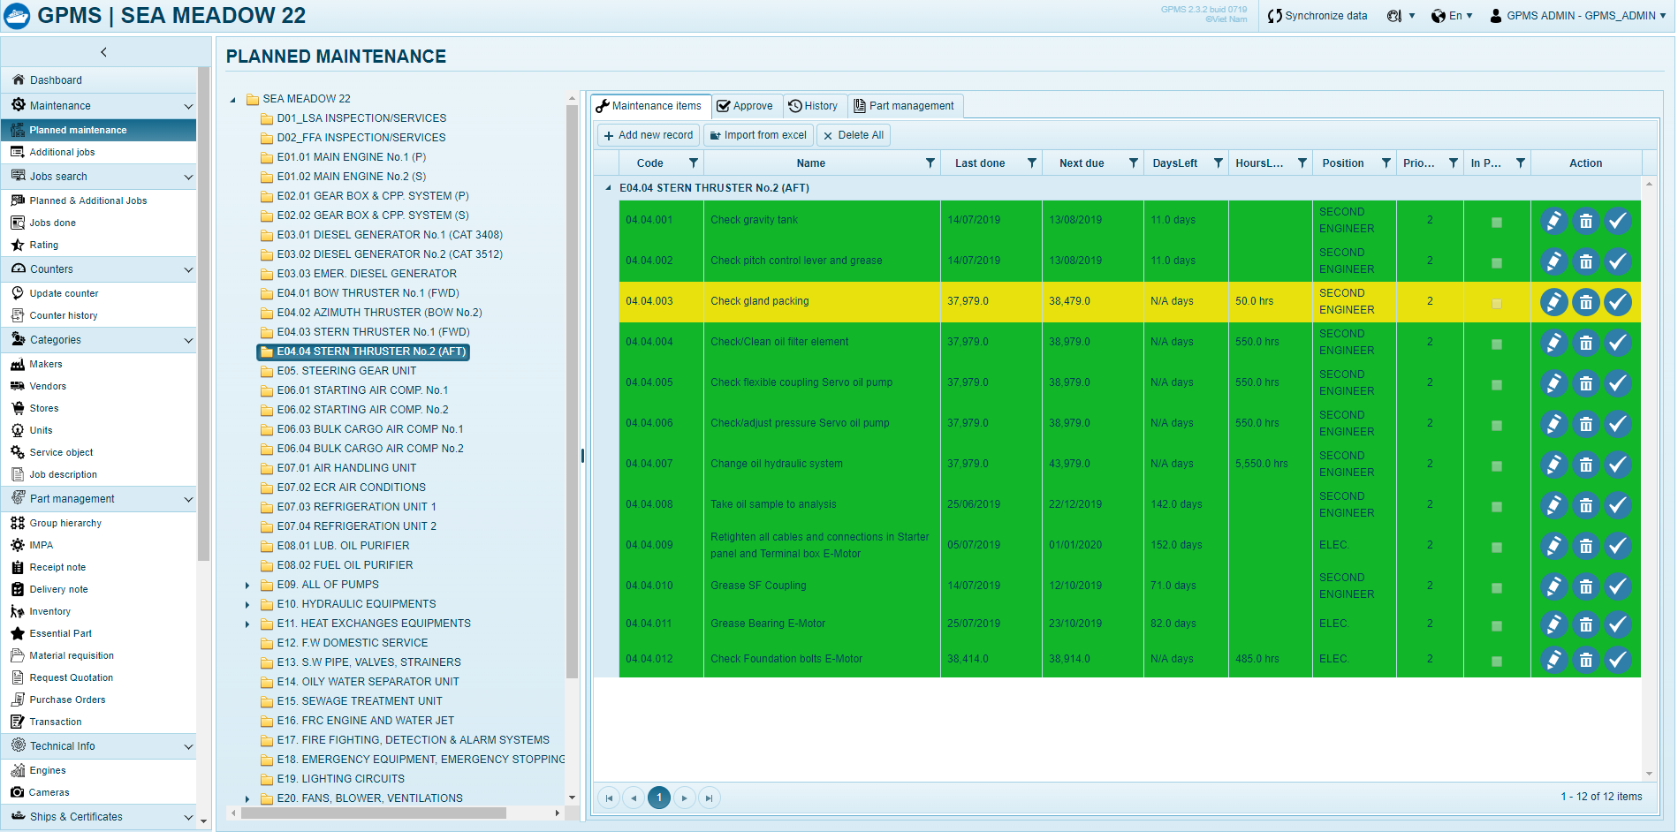
Hinh GPMS

Slide 13
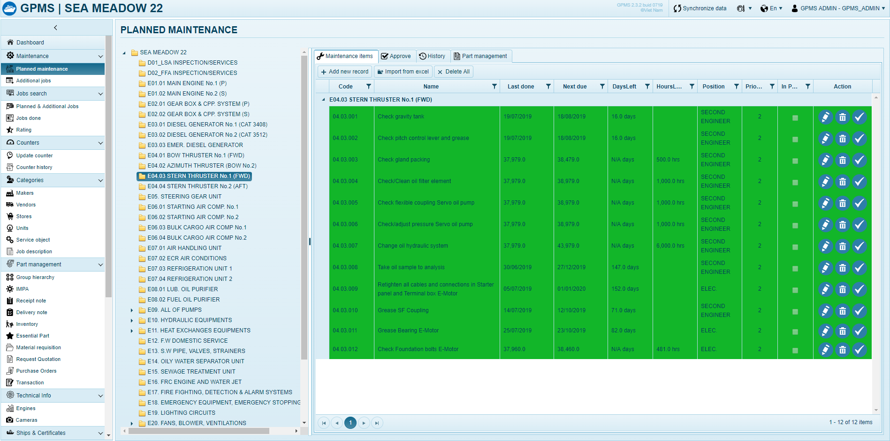
Hinh GPMS

Slide 14
OUR MAINTENANCE STRATEGY IS TO BE PR-OACTIVE AND FOCUS ON PREVENTIVE MAINTENANCE
6 MONTH INTERNAL TECHNICAL INSPECTION
In addition to the Preventive Maintenance, we send Technical Superintendents to our vessels for internal technical inspection for every 6 months to ensure all equipment onboard are in good condition.
FOR SPARE PARTS
We always order genuine spare parts from trusted dealers such as Phu Thai (Caterpillar), Wartsila, Kawasaki, etc. in Vietnam, Singapore, Germany, Japan.

Slide 15
HOW WE IMPROVE
REVIEWING LIST OF CRITICAL EQUIPMENT
Review the list of critical equipment fitted on all vessels in fleet to enhance the accuracy of spare part order and application of maintenance regime recommended by Makers
STUDYING SOLUTIONS TO EARLY DETECT A MACHINE FAILURE / CONDITION BASED MONITORING
REVIEW CREW COMPETENCY AND TRAINING, ESPECIALLY ON CRITICAL EQUIPMENT OPERATIONS AND MAINTENANCE
HARNESS THE USE OF GPMS TO MANAGE THE FLEET MAINTENANCE MORE EFFECTIVELY
START TO BUILD A SET OF KPI TO MEASURE THE EFFECTIVENESS OF MAINTANANCE OF THE ENTIRE FLEET.
Notes:
Regularly check condition of lubricating oil to find an abnormal condition - lube oil analysis for 3 month interval

Slide 16
Review vessel mobilization procedure

Slide 17
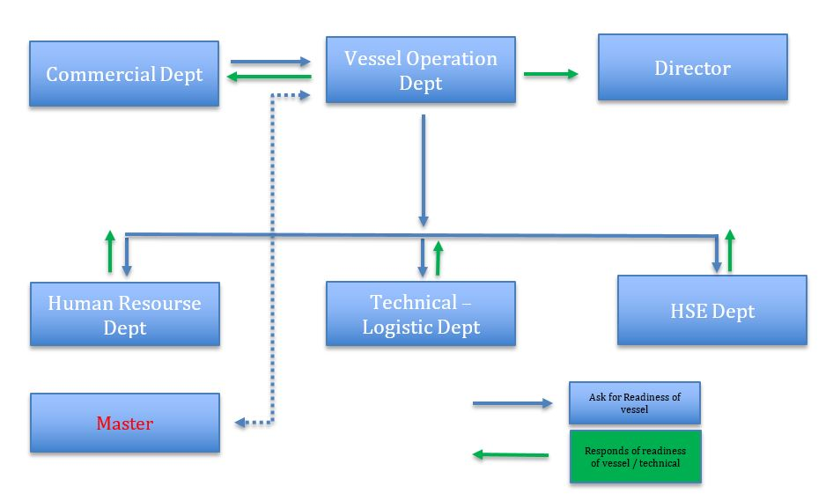
CURRENT VESSEL MOBILIZATION PROCEDURE
MASTER / C.E

Slide 18
1. JOB PREPARATION
+ Besides routine maintenance, we also request Technical Department and key crew on board to regularly carry out function test for all equipment.
+ Request Commercial Department to work with client to give a reasonable mobilization advance notice i.e 2 days.
+ Request HR Department to staff the man power with someone suitable for the job and familiar with the vessel.
+ Always ask client to clarify scope of work and technical requirements for each different job.
+ Keep client timely informed if any discrepancy between Vessel and/or Crew and their requirements for client’s consideration and decision making.
HOW WE IMPROVE

Slide 19
CHANGE OF JOB LOCATION AND SOW
+ Request captain/key person to be in office for briefing about SOW, guideline, field drawing to make sure captain and key person clearly understood
+ Request and remind the crew to diligently focus on task.
HOW WE IMPROVE

Slide 20
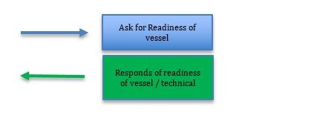
HOW WE IMPROVE
MASTER / C.E

Slide 21
An integrated resource development plan covering hardware, software and people together with Haduco’ s business development plan

Slide 22
OUR GROWTH
1.We have been embracing aggressively growth strategy to capitalize the industry downturn opportunity.
2.We have invested heavily in buying young vessels, upgrading the facilities as well as machinery and equipment. Our fleet has growth from 1 in 2013 up to 26 vessels in 2019.
3.It is a big challenge to keep our other resources growing in harmonizing with the fleet but we are trying to perfect that everyday to serve our client better and better.
Purchase |  | Total
2013 | 1 | 1
2014 | 3 | 4
2015 | 2 | 6
2016 | 2 | 8
2017 | 5 | 13
2018 | 7 | 20
2019 | 6 | 26

Slide 23
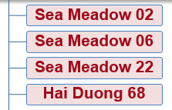
HOW WE UPGRADE
Focus on the fully-equipped high-tech vessels having averaged age of 03 – 08 years old (such as: HD86 built 2011, HD88 built 2012, HD89 built 2012, HD68 built 2012, HD29 built 2011, HD39 built 2016) and
Only say yes to well-qualified part makers (such as: European and Japanese made), which do allow us to safely perform the work.
AHTS 5,000 – 7,000 BHP
Hai Duong 01
AHTS > 7,000 BHP
Hai Duong 101
Hai Duong 08
Hai Duong 09
Hai Duong 11
Hai Duong 12
Hai Duong 16
Sea Meadow 05
Sea Meadow 19
Sea Meadow 29
Hai Duong 29
Hai Duong 39
Hai Duong 86
Hai Duong 88
Hai Duong 89
PSV
Hai Duong 22
Hai Duong 18
Hai Duong 19
Hai Duong 79
With the aim to punctually, actively self-supply and promptly react to the fast-growing fleet, we are presently proceeding to build a supply port combined with a dock based in Long Son island where is about 5 miles away from PTSC Supply Base. Furthermore, we as well have other investments on subsidiaries to provide food provisions, agency services, bunker supply, etc.

Slide 24
UP-TO-DATE HARDWARE, SOFTWARE AND PEOPLE
Along with hardware, software is an indispensable link of the integrated resource chain, which needs to be much invested with high frequency. We have been applying Green Plan Maintenance System (GPMS) in order to timely monitor and fully execute the maintenance plan on the fleet and Green Computer Base Training (GCBT), which is a system to effectively train and improve the crew skill on low cost basis.
In parallel, investment on people is a best must to harmonize with and eligible for the up-to-date hardware and software. We often send our people oversea (Singapore, Thailand) for advanced training courses such as DP maintenance, DP Operation, Rigging, Slinging, FRC, etc. in order for us to have high skill manpower. Noticeably with crew globalization strategy in our recruitment policy, we are able to access to a plentiful resource of manpower from different countries in South East Asia like Indonesia, Thailand, Malaysia, Myanmar, etc. where are having a great number of well-experienced crew in marine field. In addition, crew globalization strategy also helps our Vietnamese crew in exchange of the good working manner and the specialized knowledge/experience. In 2018, we already trained and recruited other 100 labors in total of 570 at now and this may be up to 700 labors in total for 2020.

Slide 25
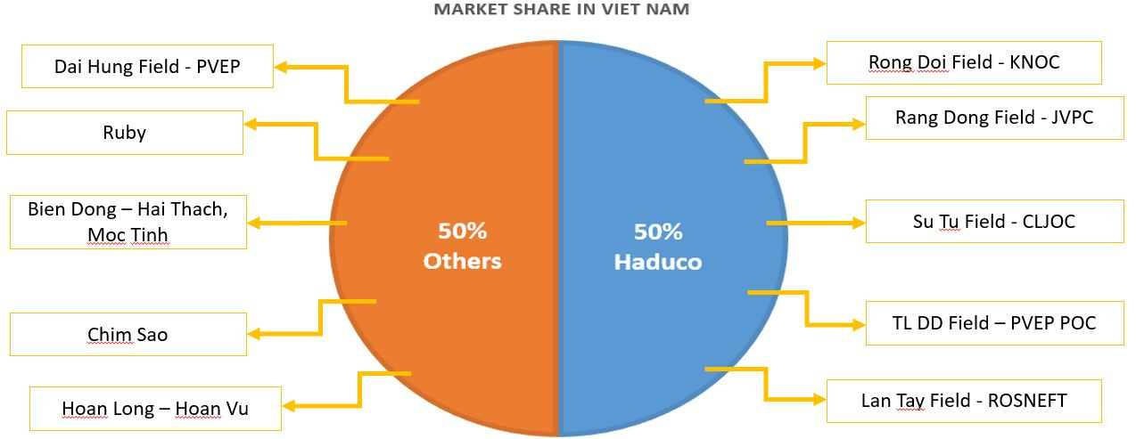
WHERE WE STAND
Proudly saying that we are currently holding 50% of market share with 07 long-term contracts in Vietnam water and confidently believing that Haduco shall succeed in obtaining more market shares in the near future.

Slide 26
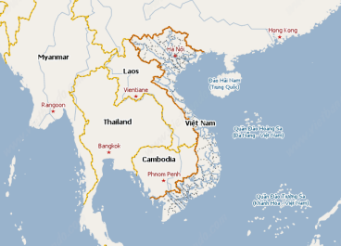
WHERE WE ARE PRESENT
Offshore Myanmar – PETRONAS Yetangun Gas Field – HAI DUONG 11
Offshore Myanmar – PETRONAS Yetangun Gas Field – HAI DUONG 16
Offshore Myanmar – PETRONAS Yetangun Gas Field – HAI DUONG 22
Offshore Myanmar – PTTEPI Zawtika Gas Field – HAI DUONG 01
Offshore Thailand – PTT Thailand – SEA MEADOW 06
AHTS HAI DUONG 08 – KNOC Rong Doi Gas Field – Offshore Vietnam
AHTS HAI DUONG 09 – ROSNEFT Lan Tay Field – Offshore Vietnam
AHTS HAI DUONG 18 – CLJOC Su Tu Field – Offshore Vietnam
AHTS HAI DUONG 101 – CLJOC Su Tu Field – Offshore Vietnam
AHTS HAI DUONG 12 – JVPC Rang Dong Field– Offshore Vietnam
AHTS HAI DUONG 19 – JVPC Rang Dong Field– Offshore Vietnam
AHTS HAI DUONG 05 – PVEP POC TLDD– Offshore Vietnam

Slide 27
WHERE WE ARE PRESENT
AHTS HAI DUONG 29 – Towing PVD 6 from Viet Nam to Labuan
AHTS SEA MEADOW 19 – Support PVD2 for drilling campaigns at Rang Dong Field
AHTS SEA MEADOW 29 – Support H5 for Rosnef drilling campaigns
AHTS SEA MEADOW 05 – Support Launching Sao Vang Dai Nguyen jacket
AHTS HAI DUONG 39 – Support Launching Sao Vang Dai Nguyen jacket
Offshore Myanmar – PETRONAS Yetangun Gas Field – HAI DUONG 11
Offshore Myanmar – PETRONAS Yetangun Gas Field – HAI DUONG 16
Offshore Myanmar – PETRONAS Yetangun Gas Field – HAI DUONG 22
Offshore Myanmar – PTTEPI Zawtika Gas Field – HAI DUONG 01
Offshore Thailand – PTT Thailand – SEA MEADOW 06
AHTS HAI DUONG 08 – KNOC Rong Doi Gas Field – Offshore Vietnam
AHTS HAI DUONG 09 – ROSNEFT Lan Tay Field – Offshore Vietnam
AHTS HAI DUONG 18 – CLJOC Su Tu Field – Offshore Vietnam
AHTS HAI DUONG 101 – CLJOC Su Tu Field – Offshore Vietnam
AHTS HAI DUONG 12 – JVPC Rang Dong Field– Offshore Vietnam
AHTS HAI DUONG 19 – JVPC Rang Dong Field– Offshore Vietnam
AHTS HAI DUONG 05 – PVEP POC TLDD– Offshore Vietnam

Slide 28
WHAT WE HAVE
Haduco is a privately owned company with very swift decision making by simplified company structure and flexible mind together with great equity capital and various self-sufficient supply chain are our key advantages to bring Haduco towards the leading position with “Low-cost but High-quality and Safety Standard” strategy in Vietnam. Contracting with Haduco will enable our clients to have not only achieve its safety prioritization but also cost optimization and efficiency maximization.

Slide 29
THANK YOU
FOR LISTENING

